Slide 1
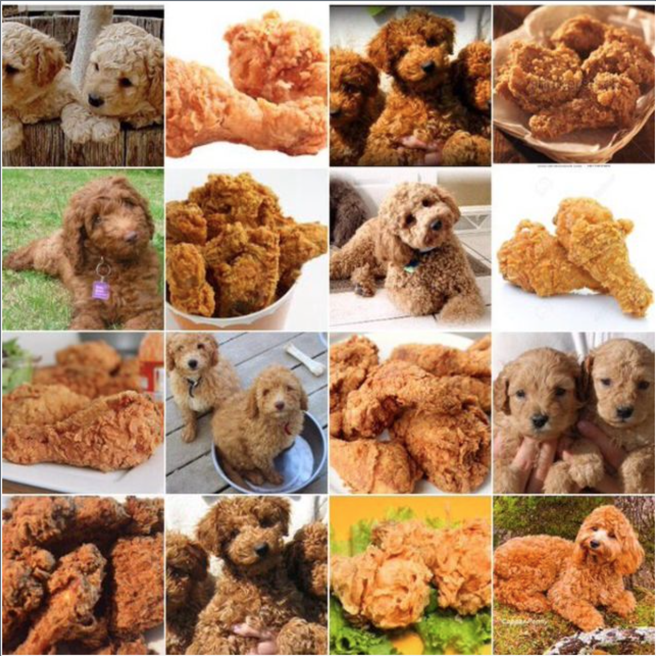
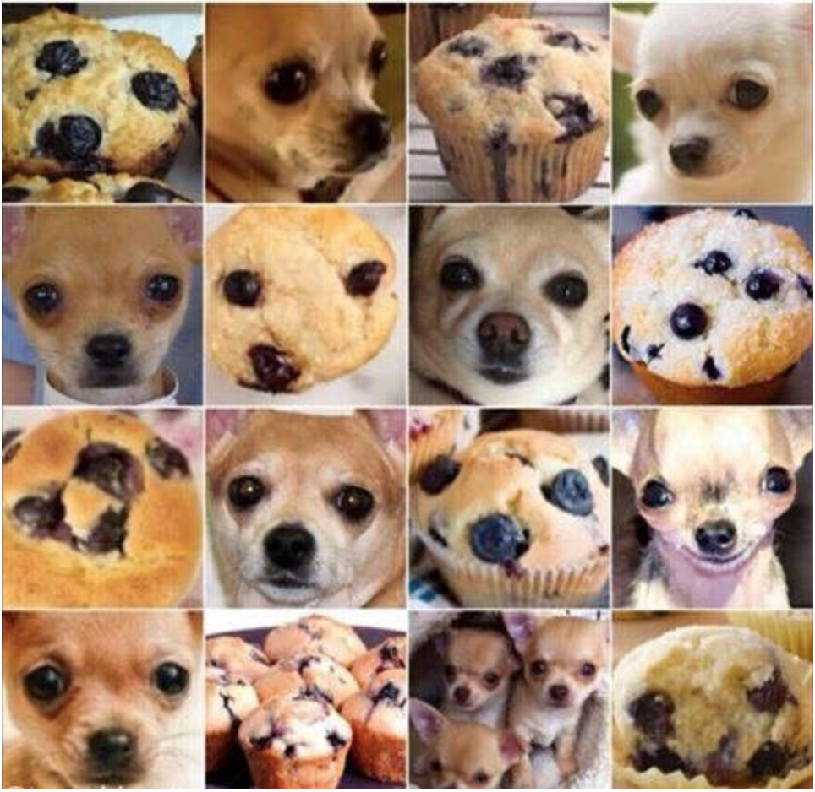
ADS Project 3 Group 3
Predictive Modeling –
Fried Chickens vs. Labrodoodles vs. Blueberry Muffins
Chaoyue Tan
Han Lin
Hongyang Yang
Peilin Qiu
Wyatt Thompson

Slide 2
INTRODUCTION
Goal:
Classify images of Fried Chickens vs. Labrodoodles vs. Blueberry Muffins
considering accuracy, time and memory cost
Baseline:
Gradient Boosting Model with SIFT feature
What we do next:
Try new models (XGBoost, Random Forest, SVM,
Logistic Regression, Neural Network)
Try new features (HOG, LBP, Gray scale)
Proposed model:
Model: XGBoost
Feature: SIFT + HOG + LBP + Gray

Slide 3
OUTLINE
Models
Feature Extraction
Analysis
Compare baseline vs proposed model

Slide 4
MODELS
Candidate models:
GBM, XGBoost, Random Forest, SVM, Logistic Regression, Neural Network
We used cross validation to tune the parameters of each model.
GBM:
n.trees(number of trees), shrinkage(learning rate)
XGBoost:
max.depth(maximum depth of a tree), num_round(The number of rounds for boosting)
Random Forest:
n.trees(number of trees)

Slide 5
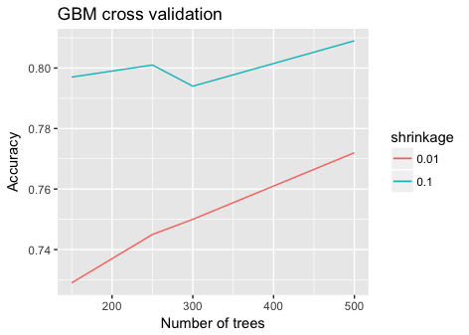
MODELS
GBM
Choose:
Number of trees: 250
Shrinkage: 0.1

Slide 6
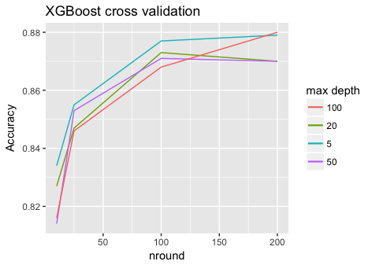
MODELS
XGBoost
Choose:
Max depth = 5
Nround = 100

Slide 7
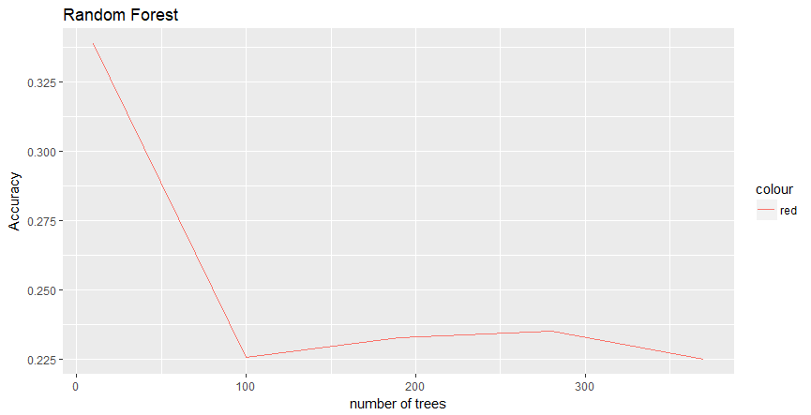
MODELS
Random Forest
Choose：
Number of trees:
100

Slide 8
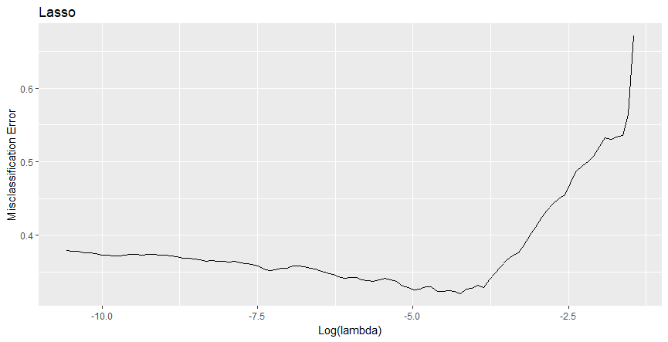
MODELS
Logistic with Lasso
Choose：
Log(lambda) = -5

Slide 9
FEATURES
Total 5763- dim feature:
5000-dim SIFT feature provided
Extract 448-dim HOG(Histogram of Oriented Gradient) feature from raw images
Extract 59-dim LBP(Local Binary Patterns) feature from raw images
Transform images to black and white and extract 256-dim gray scale feature

Slide 10
ANALYSIS
Predicting accuracy of different models with different features
 | SIFT | SIFT+HOG | SIFT+HOG+LBP | SIFT+LBP+HOG+Gray256
GBM | 0.800 | 0.863 | 0.872 | 0.880
xgboost | 0.819 | 0.867 | 0.877 | 0.890
Random Forest | 0.790 | 0.834 | 0.832 | 0.839
Logistic | 0.694 | 0.813 | 0.844
Logistic with Lasso | 0.702 | 0.826 | 0.836
Neural Network | 0.610 | 0.700

Slide 11
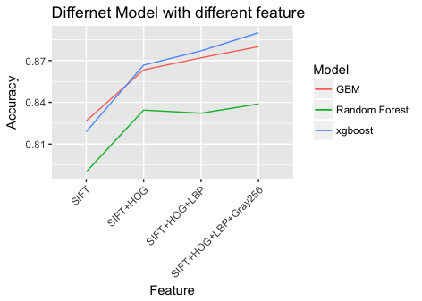
ANALYSIS

Slide 12
COMPARISON
Proposed model:
Model: XGBoost
Feature: SIFT + HOG + LBP + Gray
 | predicting accuracy | training time | predicting time | Size
baseline model (GBM+SIFT) | 0.8 | 152.279 | 7.629 | 79MB
proposed model | 0.89 | 193.722 | 0.392 | 184KB

